Slide 1

MOVIE RECOMMENDATION SYSTEM
Amaranath Gaddamadugu
Sainikith Vodapally
Sindhu Pineedi
Bharadwaj Tadepalli

Slide 2
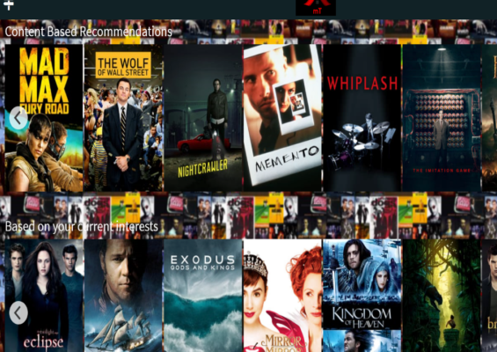
INTRODUCTION
Objective: Develop a personalized movie recommendation system to navigate the paradox of choice in digital streaming.
Challenge: With the proliferation of movies, viewers face decision fatigue and decreased satisfaction.
Solution: Use content-based filtering techniques to analyze movie metadata like director names, actor names, genres, and titles.
User Experience: Enhance user satisfaction and engagement by offering more relevant and engaging content suggestions.
Goal: Demonstrate the effectiveness of content-based filtering in improving user engagement within the digital entertainment industry.

Slide 3
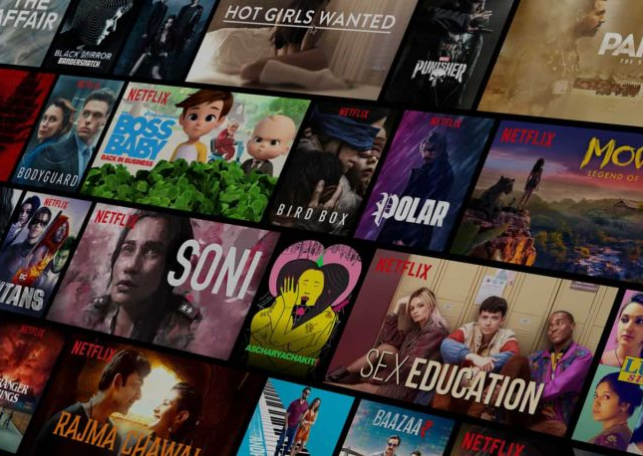
PROJECT BACKGROUND
Digital Entertainment Landscape: Characterized by an overwhelming abundance of content across streaming platforms like Netflix.
User Challenges: Difficulty in finding content that matches individual interests due to the vast selection available.
Role of Recommendation System: Personalize content delivery based on user preferences, viewing history, and demographics. Reduce cognitive load by suggesting content similar to what users have previously enjoyed.
Business Impact: Recommendation systems are essential for maintaining a competitive edge in a saturated market. Help ensure users remain engaged and less likely to explore alternative services.

Slide 4

DATA COLLECTION & PREPARATION
Primary Sources: Utilized Kaggle's "The Movies Dataset" covering films up to July 2017.
Augmented with additional movie data from 2017 to 2019 from Wikipedia to keep the dataset up-to-date.
Included genres, director and actor names, movie titles, and more to enrich the dataset.
Merged various data sources to create a unified database. Ensured consistency in movie titles and other categorical data.
Addressed missing entries by filling with "unknown" or using interpolation where applicable.
Converted all text data to a uniform lowercase format to avoid discrepancies in data processing.

Slide 5

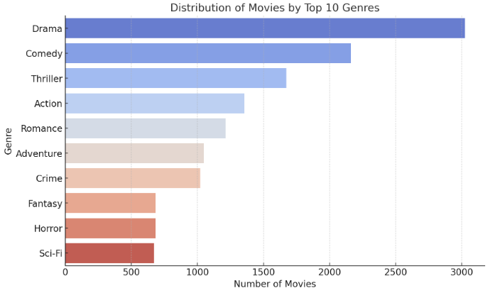
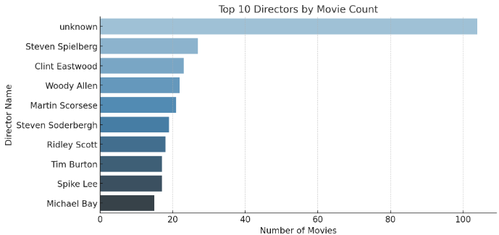
CINEMATIC INFLUENCES & GENRE POPULARITY
Drama tops as the most prevalent genre, followed by comedy and thrillers.
Action and romance genres' strong showing reflects a demand for excitement and emotional narratives.
The presence of fantasy and sci-fi underscores the allure of escapism and futuristic themes.
At the top, heavyweights like Steven Spielberg, Clint Eastwood, and Woody Allen, each contributing upwards of 30 films to the silver screen.
Personalized suggestions may favor films from directors with a history of audience appeal.
Significance: Directors' filmographies shape recommendation algorithms.

Slide 6

FEATURE ENGINEERING & DATA TRANSFORMATION
Developed 'comb' column to encapsulate key movie attributes.
Integrated director names to capture thematic and stylistic influence.
Included lead and supporting actors, recognizing their pull-on audience preferences.
Categorized movies by genre for thematic grouping.
Utilized movie titles for additional thematic insights.
Transformed 'comb' text data into a machine-readable TF-IDF matrix.
Quantified word significance to analyze textual similarity.
Created a scalable foundation for assessing movie likenesses.
Enabled effective generation of personalized movie recommendations.

Slide 7

MODEL DEVELOPMENT
Tokenized 'comb' column text using the text2vec package in R. Created a Document-Term Matrix (DTM) to structure the corpus mathematically.
Applied TF-IDF transformation to weight term significance. Utilized cosine similarity measures to quantify movie content relationships.
Constructed a similarity matrix as the core of the recommendation engine.
Developed a function to retrieve movie suggestions based on cosine scores.
Enabled personalized recommendations by matching user preferences to movie profiles.

Slide 8
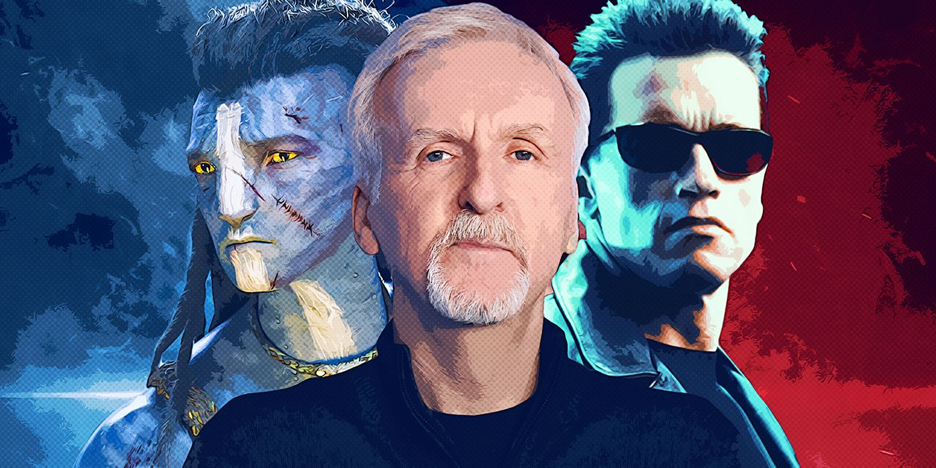
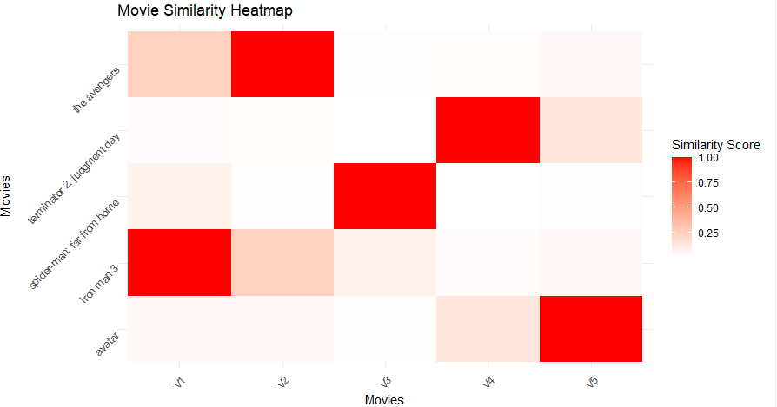
MOVIE SIMILARITY HEATMAP
Selected a diverse range of movies to demonstrate the model's robustness. Visualized content relationships through a movie similarity heatmap.

Slide 9
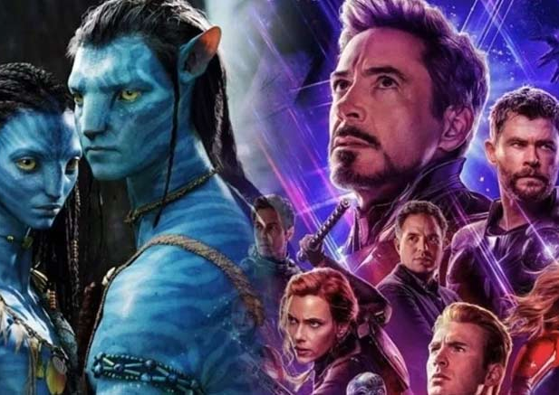
SIMILARITY ANALYSIS
Inter-movie Relationships: Illustrated strong similarities within the Marvel Cinematic Universe.
"Avatar" displayed unique thematic elements, distinct from MCU films.
"Terminator 2: Judgment Day" showed moderate similarity to superhero movies, suggesting action and technology as unifying elements.
Insights: Confirmed the model’s ability to identify narrative and thematic connections.
Highlighted the potential for universe-centric recommendations for fans.
Revealed directorial influence, with James Cameron’s distinct style transcending genre boundaries.

Slide 10

CHALLENGES & LEARNINGS
Overcoming inconsistencies in merging datasets from various sources.
Capturing the subtleties of movie metadata beyond basic categorical data.
Ensuring recommendations span a broad range of genres without overfitting to popular choices.
Algorithm selection: The effectiveness of TF-IDF and cosine similarity for content-based recommendation systems.
Understanding user behavior requires both explicit and implicit feedback mechanisms.
Insights into building a scalable system that can adapt to an expanding dataset and evolving user tastes.

Slide 11
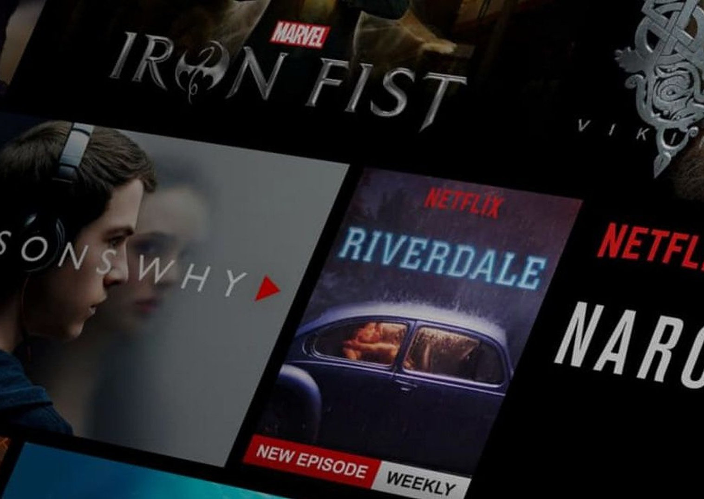
CONCLUSION
Demonstrated the effective personalization of content delivery, addressing the paradox of choice in digital streaming.
Successfully developed a content-based movie recommendation system that enhances user experience.
The system significantly improves user engagement by providing tailored movie suggestions.
Showcases the potential of content-based filtering techniques to revolutionize movie recommendations in the entertainment industry.
The project underlines the importance of sophisticated data analytics in creating meaningful user experiences.

